Slide 1


Make an impact in meetings, calls, networking events, informal events
Be aware of your personal brand and its impact on others.
Influence others through reasoning and building positive relationships
Use multiple colors of your personality to get the point across

Slide 2
Your need as we understand
Genpact GOLD (Genpact Operations Leadership Development) is a high profile, high visibility learning journey for Band 4 Operations leaders at Genpact. (Managers to Sr. Managers population) Genpact selects 85 odd leaders from 900 applications to be a part of this 18 month leadership journey. The participants are selected based on an online assessment and their last 3 appraisals. A GOLD batch, starts in January and graduates in May, the following year.
Background
MaynardLeigh has been hired to lead the first phase of the GOLD journey this year, where 85 participants have been selected from across the globe (With different nationalities) who travel to Hyderabad for the phase1. Some of the scenarios you’d like us to work on are-
Elevator Pitches, Being able to hold a spontaneous conversation with a leader, being concise- knowing how much to share with whom, holding difficult conversations, being able to network.
Situation
Genpact wants these (GOLD) leaders to stand out from the rest of the population. The participants are given a Golden Lanyard, to differentiate them on the floor- the need is to stand out even without that. As a part of the journey, they get to work with different teams and are also given an opportunity to change their roles, the leaders should make their presence felt wherever they go.
Opportunity
Genpact has hired MaynardLeigh to deliver a bespoke solution which could really bring about a change in the participants. You want us to create an experiential journey to give ample opportunities for the participants to practice, rehearse and get feedback.
Need
3

Slide 3
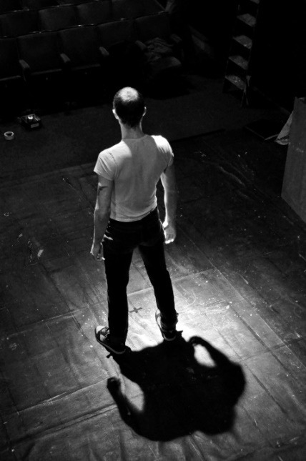
The ABC of Charisma
Actors have been known for ages to have ‘Star like quality’ which leads them to exude confidence and move an entire auditorium full of people. They have an inherent ability to use a wide range of emotions to be able to make the audience feel what the script demands of them.
Our directors knew that “The inner substance speaks much louder and clearer than the outer masks” Hence, they would spend most time having the actor connect with the character, its thoughts, it’s body and spend little time on the schematics, costumes etc.
Aim
Every communication has a purpose.
What’s the impression you want to leave your audience with?
Being yourself
-Are you bringing your whole self or are their parts of your personality behind
-Using your natural charisma and gravitas
Chemistry
-Focus of attention
-Building relations
- Emotional and social intelligence
-Impact in your interactions & presentations.

Slide 4
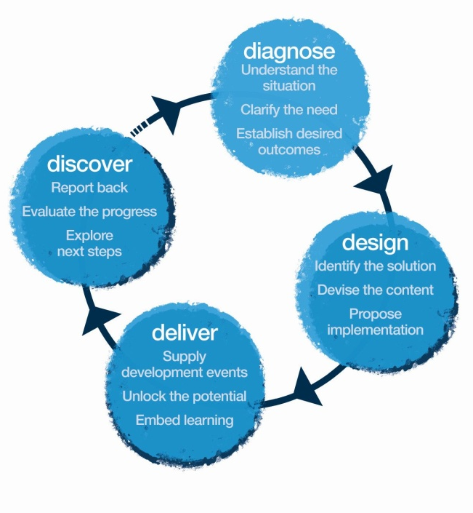
Our Approach
Methodology
We create experiential learning solutions using principles from Theatre Psychology and L&D tools.

Slide 5


Diagnosis
We spent time on one-on-one calls speaking to a few target participants, GOLD Alumni and
HR Stakeholders to customize the program design according to your need.
All the combined inputs have been incorporated into the design to make it more relevant.
We checked for information on:
Current scenarios of their interactions with their stakeholders
Current State - what’s working, areas of strengths, challenges, etc.
Gather anecdotes, examples & situations relevant for the workshop
Their expectations from the workshop

Slide 6
Diagnosis – Profiling
We conducted ½ hour telephonic interviews with 9 target participants
3 GOLD Alumni
2 HR Stakeholders
Total number of respondents – 14 sample size

Slide 7
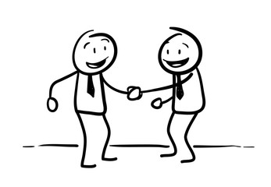


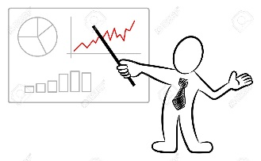
Diagnosis – Modes of communication with stakeholders
4 out of 9 participants said that face to face communication was their preferred mode, especially when an issue needed their deeper attention or when their team was available at close quarters.
Calls and Webex are the most used medium for quick fixes, formals status updates, etc.
For larger group communications, email came through as more dependable than phone calls. About 3 out of 9 participants depended on emails more than phone calls.
Presentation decks are commonly used to communicate with senior leadership and customers.

Slide 8


Diagnosis – Key Challenge Areas (participant view)
ASSERTIVENESS
Being able to powerfully communicate with senior leadership, communicate tough news to the team, be able to say no, take difficult decisions, accept praise, influence others
LISTENING & CONNECTING
Understand other people’s perspectives better, understand people across cultures, anticipate questions, be less verbose , be less transactional and make connections
STRUCTURING
Being able to be fluent, understanding the objective of communication, structuring my thoughts
*Highest to lowest in terms of popular / group opinion

Slide 9
Diagnosis – Key Challenge Areas (participant view) - anecdotes
ASSERTIVENESS
“I couldn’t say what I really wanted to in front of the VP.” “One day Tiger spoke to me and I was so nervous, I was sweating in fear.”
“I want to be able to push people to meet their timelines a little more.”
LISTENING& CONNECTING
“I am very careful when I speak to others, what if they don’t understand me.”
“When a front line manager resigned, I spoke to the person describing all the plans I had for him, I didn’t allow him to share anything.”
STRUCTURING
“My own thoughts need to be clear.”
“I want to be very clear about what the objective of the conversation is, especially when I write emails.”

Slide 10
Diagnosis – Key Challenge Areas (HR leadership & Alumni view)
ENGAGEMENT & OWNERSHIP
Shying away from conversations with leadership, inhibitions, don’t communicate with customers about the digital wave/innovation, lack of confidence, don’t create their own personal brand, learn to create impact in the virtual world, use personal stories, proactively drive conversations
COLLABORATION
Creating a coach relationship with their team, collaborate with other teams for sharing knowledge, building rapport with clients
BEING SPECIFIC
Not being precise or specific, tendency to be verbose to impress
*Lowest to highest in terms of stated area of gap

Slide 11
Diagnosis – expectations from the workshop
The following are some of the expectations participants have from the program:
To meet people from across the world and have open discussions (not like a school)
Want to discover something new about myself
Something like the program ‘Leadership Walk’ that we have already attended
Learn how to express my opinions in the boardroom and how to say no
A practice ground where I can go and actually try something new
Learn how to be a better leader

Slide 12

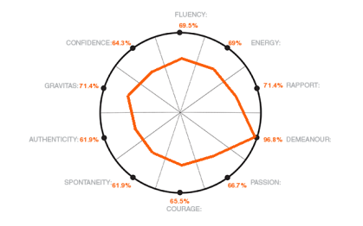
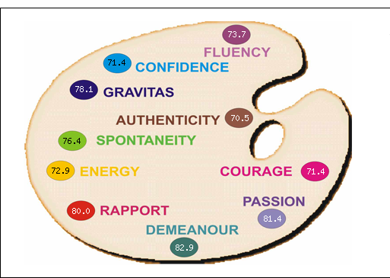



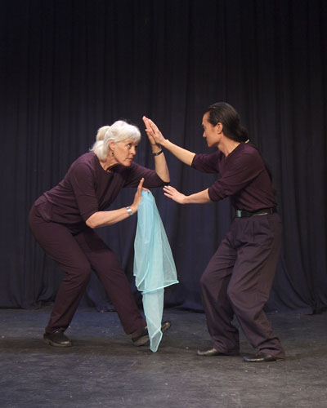
Tentative PERSONAL IMPACT Journey
3
Reading the Book
2
1
Personal Impact Profile
Profile Debrief Call
2- Day Personal Impact Workshop
4
7
Implementation Day
5
Goal Tracking
6
One on One Coaching X 2

Slide 13

1
The Personal Impact Profile
Online Assessment
Each participant and up to 5 of their chosen “supporters” complete an online assessment which will have a set of questions regarding their Personal Impact. They will each need to take out approximately 12 to 15 minutes to complete this assessment.
This MLA (PI) profile gives valuable feedback on ten key behaviours, to see how many colours one is using from his/her palette.

Slide 14
2
Profile debrief call with the consultant
Need of this call – A call with the consultant to discuss the profile, interpret results, decipher statistical facts and free form comments. This is to create a clear vision towards the personal development of the participant during the workshop.
Time - 45 Minutes.

Slide 15
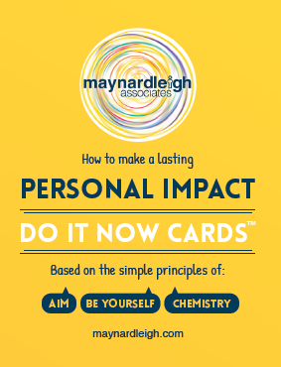


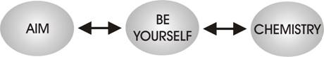
3
Charisma Effect book- Pre-read before workshop
Workshop is supported by
Objectives – Maynard Leigh has a rich heritage of producing some of the best selling publications capturing our philosophies, detailing how we inspire greater impact. Charisma Effect is one such publication, now translated in over 30 countries. A simple to read book unraveling the secrets of making a lasting impression.
Participants receive a copy of this book before the workshop to study relevant chapter/s corresponding to areas identified as their strengths/development needs from the Personal Impact profile.

Slide 16
Design – Personal Impact Workshop Objectives
4
Think
Being authentic and true to my own brand’s values is magnetic
By clarifying the impact I want to have, I have more chance of meeting it
I am making an impact at every moment- consciously and unconsciously
Everything makes an impact- entrance, body language, voice
I have the tools to impress and establish credibility/ authority
Every interaction, presentation is a moment of impact, I will make each count
I will give my audience my complete attention and be present to them by being my authentic self
Being in rapport is a two-way street and important to team productivity
Be more able to:
Influence at the highest level
Express my opinions and points of view concisely & effectively
Convey gravitas and natural authority even during elevator pitches
Have tough client conversations
Increase ability to gain buy-in and create impact through increased personal presence/charisma
Build relationships/network with Clients, seniors, peers and team
Use personal stories to build connect and creative productive working relationships
Feel:
Confident in leading conversations
More aware & assured about myself
More present to my audience
Connected to my own true self
Equal with people around me
Capable of influencing outcomes of meetings/discussions
Excited about creating impact

Slide 17
Design – Personal Impact Workshop Outline – Day 1
Session | Session details | Methodology | Objective targeted in this session | Relevant Examples
Introduction 9 – 9.30am | Welcome and context setting MLA introduction & party mingling Permissive Encouragement – Play & Express yourself | Theatrical warm ups Experiential Context setting | Get in touch with one’s ability to be authentic and expressive | “It shouldn’t be a boring classroom session.” “I really want to get to know my fellow participants!”
The first impression 9.30 – 10am | What creates the first impression Receiving feedback on my impact Understanding the nature of impact | Participant led mutual feedback exercise. Facilitator led impact exercises. | Make a good first impression Articulate adequately in all channels (virtual and in person) | “It’s difficult for me to open conversations with clients, the first impression is the hardest part. Want to be able to strike better first conversations.”
Prepared communication 10-10.45am | Participants present their 1 minute prepared introduction. They will be asked to come prepared with this before the workshop. | Recording Participant presentations | To be able to identify one’s issues by means of video playback
 | TEA Break - 10.45-11am

Slide 18
Design – Personal Impact Workshop Outline – Day 1 (Contd.)
Session | Session details | Methodology | Objective targeted in this session | Relevant Examples
AIM 11-12.30pm | Clarifying objectives. What is the purpose of any communication? What would a positive outcome look like? Structuring communication for Impact | Facilitator led presentation. Participant exercises. | Be Precise and Impactful in delivering message. Structure Communication . | “Sometimes I struggle to be clear about my objective specially when writing emails to big groups. I wish I could do that faster.”
 | LUNCH - 12.30-1.30pm
Be Yourself 1.30-3pm (Tea Break) 3-3.15pm Be Yourself (contd.) 3.15-4.45pm | Physical Self - Improving Stature Feeling high status and exhibiting high self esteem. Being assertive. | Practical exercise Participant practice | Establish credibility/ authority. Communicate with authenticity and confidence. | “When Tiger spoke to me the other day, I was so scared that I was sweating under my collar!” “It’s difficult to speak your mind with seniors in the picture.” “The cuture is such that Yes Men have been created.”
Closing 4.45-5pm | Participants finalize what they will START doing, STOP doing & CONTINUE doing. H.W. – Change Your Impact, Mirror Exercise & 2 things from Tips for Social Situations Goodbyes | Action planning Completion

Slide 19
Design – Personal Impact Workshop Outline – Day 2
Session | Session details | Methodology | Objective targeted in this session | Relevant examples
Hello! & Recap 9-9.15am | Recap of Day 1 & Participant peer coaching partnerships created for the rest of the day.
Projecting quality 9.15-10am | Recognizing & branding my personal quality. What is the point of me? And What is my Point of view? Brand gallery | Participant led self branding exercise Viewing each other’s Brand in a group created gallery | Check & Identify own tendencies & behaviors. Connected to own integrity. | “Over the years I have come to form a brand but every brand needs a 2 point O.”
Chemistry (Using Meeting Simulation) 10-12.30pm Tea 10.45-11am | Attention - Choosing where to focus. Focusing attention on the other person or people. Interdependence - Working creatively in partnership and collaboration with others.. Rapport - Mirroring and developing sensitivity to others, Developing empathy, Understanding the other person. Understanding different global cultural nuances | Facilitator led psychodrama exercises | Capable in influencing outcomes of meetings/discussions Comfortable in influencing people and teams. Follow global protocols in interaction Building rapport – able to listen & connect with stakeholders | “I want to be able to listen to people better.” “Many times I find myself saying that the job needs to get done, it makes all my interactions very to the point.”

Slide 20
Design – Personal Impact Workshop Outline – Day 2 (Contd.)
Session | Session details | Methodology | Objective targeted in this session | Relevant examples
The Practice Room 1.30-3pm 3.15-4.45pm | Simulating challenging situations and getting participants to respond A chance to respond with your unique leadership style Not a win-win but purposeful choices | Participants practice (using props) | Capable in influencing outcomes of elevator pitches/ meetings/discussions. Comfortable in influencing people and teams. | “The session needs to be all about getting up and practicing.” (Using ABC as a lens)
 | Tea Break – 3-3.15pm
Choosing Goals & Closing | Participants finalize what they will START doing, STOP doing & CONTINUE doing. Finalizing the Goals to work on. Goodbyes | Finalizing goals for each participant.

Slide 21

Ambience
We love alternative ways of setting up a workshop! Creating an atmosphere where the participants feels absolutely comfortable and yet challenged. In this workshop, the use of theatre, team games and experiential methodologies are essential ingredients, hence we’d require ample place to move around and make noise.
Please book a space with ample natural light (Yes, we want sunlight streaming in) and no fixed furniture for 8 Participants to work with one MaynardLeigh consultant.

Slide 22
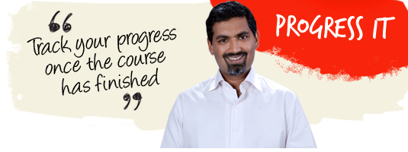
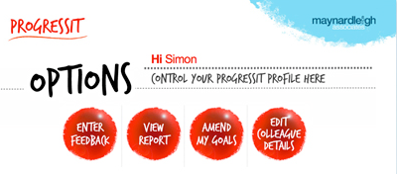
5
9- Week Goal tracking system
ProgressIt ® is a powerful on-line support system that provides follow through after a course, a workshop or learning event. We use this innovative service to:
Help participants reach their self selected behavioural goals
Show line managers what their colleagues have learned and report on the business results from their new learning
Enable Human Resources departments to offer evidence of specific business gains stemming from a particular learning experience.
Assign supporters to these participants who will give feedback for a period of nine weeks.
ProgressIt ® tackles these with a nine-week support service and a report at the end summarizing progress. (URL for this needs to be whitelisted).

Slide 23
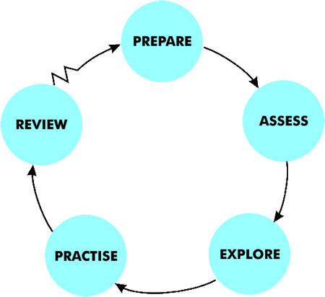
6
One on one - Coaching Sessions
In-Person coaching
We suggest 2 In-person coaching sessions for each participant for 60 Minutes each during the journey. (The 42 international participants will get on a Skype/Video call with the consultants)
Maynard Leigh coaches possess particular skills in creating a safe place in which to practise new ways of thinking and behaving.
The Maynard Leigh performance coaching experience resembles the relationship between a theatre or film director and an actor. The director’s job in rehearsal is to unlock the actor’s potential in order to deliver outstanding performance. They do this in many ways using insightful feedback, suggesting exercises, encouraging experimentation and working in a creative partnership. This is why actors will always expect to get up on their feet and try things out in the rehearsal stage of a production
These sessions will allow the coach & the executive to delve deeper into the area of development and as the sessions progress they will be better suited to practise the learning and revisit what worked & what could be better . Coaching makes a huge impact.

Slide 24
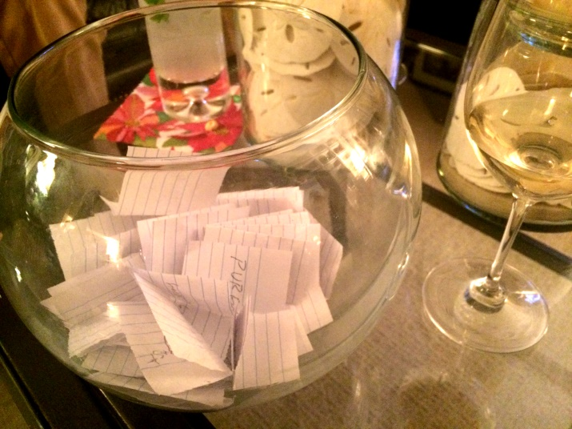
7
Implementation Day
Implementation Day
The 8 participants meet again in September to discuss, practise, share & coach each other in the areas that they found difficult to implement from the workshop.
We ask participants to put challenging situations/stakeholders on chits and drop them in a fish bowl to ensure anonymity. We pick one scenario after another and the facilitator creates an active learning space to simulate, practice and rehearse ways to overcome challenges.
Duration 1 day
1 Maynardleigh facilitator with 8 participants.

Slide 25

Next Steps
Diagnosis Meetings- Given we are to schedule this workshop in January, it is imperative to schedule the diagnostic meetings over the next month.
Booking the workshop venues/Dates- You will need to book 10 workshop rooms and we need to book dates for 10 of our consultants. We’d need to immediately schedule these to ensure availability at both our ends.
Expedite – We’ve finalized the commercials with your procurement team, we will need to expedite the contracting and PO process.

Slide 26
Program Plan
Date | Day | Activity | Responsibility
10-Jan | Tuesday | Share the diagnostic meetings slots | MaynardLeigh
11-Jan | Wednesday | Participant Profile Sheet with Participants details | Genpact to send us the sheet by 11th Jan
12-Jan | Thursday | Genpact to share the the confirmed meeting slots for Diagnosis | Genpact
12-Jan | Thursday | Initiate Personal Impact Profile for all participants | Maynardleigh - We will send an introductory email to Participants about Personal Impact Profile , they would also receive an auto generate emails from the online tool.
12-Jan | Thursday | Coaching Call Schedule to be sent | MaynardLeigh shall send the coaching call schedule with the timeslots and batches accordingly
16-17 January | Monday and Tuesday | Diagnostic Meetings are scheduled | MaynardLeigh consultant spents two days meeting target participants, Genpact to manage the logistics.
19-Jan | Thursday | Charisma Effect Books couriered | MaynardLeigh, we shall courier the Charisma Effect to the Genpact office which is to be handed over to the participants before the Coaching calls
23-Jan | Monday | MaynardLeigh- Workshop design presentation | MaynardLeigh presents the workshop timelines to Genpact stakeholders
23-Jan | Monday | Final Coaching Call Schedule to be received | Genpact to schedule the calls and send the final schedule to us
30th Jan- 3rd Feb | Whole week | Coaching calls to be conducted by facilitators | Genpact & Maynardleigh (Coordination)
21st & 22nd Feb | Tuesday & Wednesday | Personal Impact Workshop | Venue, Lunch arrangements , things required for the workshop to be taken care by Genpact.
21-Feb | Tuesday | Progress IT – Online Goal Tracking Mechanism initiated | Maynardleigh sents the mail to the participants. Participants enter their goal post the workshop on 22nd/23rd Feb
9th March | Thursday | In-Person Coaching Session Schedule to be sent | Maynardleigh
20th March | Monday | Final Coaching Session schedule to be received | Genpact
To be decided | To be decided | One on One Coaching Session | Genpact & Maynardleigh (Coordination)

Slide 27
Your Investment
Investment for One batch of The Personal Impact Journey with 85 Participants
Design and Diagnosis (One time investment) Two-consulting days for Diagnosis Interviews One-day customization of the workshop content | Rs. 30,000 X 2 Days Rs. 30,000 X 1 Days | Rs. 90,000/-
Pre- Workshop- Pre- program Personal Impact Profile Charisma Effect Book, Do-it-Now Cards and workshop Material One-on One Coaching Call (45 minutes with each participant) | Rs.400 per participant X 85 Rs. 880 per participant X 85 Rs. 4500 per Participant X 85 | Rs. 34,000/- Rs.74,800/- Rs.3,82,500/-
Workshop Delivery Charges Professional Fee for delivery (8 Participants per batch - 10 Batches X 2 Days) In-person Coaching Session For participants in India (43 Participants) [2 sessions per participant for 60 minutes each] Skype Coaching for participants located outside India( 42 participants) [2 sessions per participant for 60 minutes each] Progress IT- Online Goal Tracking System Implementation Day (10 Batches X 1 day) | Rs.55,000 Per day Per Consultant X 20 Consulting days Rs.8,000 Per Coaching Session X 2 X 43 Participants Rs.5,500 Per Coaching Session X 2 X 43 Participants Rs.200 per participant X 85 Rs.55,000 Per day Per Consultant X 10 Consulting days | Rs.11,00,000/- Rs.6,88,000/- Rs.4,62,000/- Rs.17,000/- Rs.5,50,000/-
Total Investment for this journey Total Investment per GOLD Leader |  | Rs. 33,98,300/- Rs.39,980/-

Slide 28
Commercial Terms & Conditions
Client is responsible for providing – 1) Venue for the training programs (with a back-up generator) should have natural lighting, enough space to do exercise and comfortable temperature for the participants & consultant 2) Conference facilities including meals 3) Audio visual equipment – (LCD projector, flip chart board stand, 8*10 ft screen)Travel outside Delhi NCR - Air, stay & airport/ venue cab transfers to be taken care by the client.
Genpact will make the following arrangements for consultants if the workshop is outside Delhi NCR or any consultant is required to fly down to Delhi (all consultants are not based in Delhi NCR) subject to business approval -
- Accommodation for consultants stay – as per band 3 policy at Genpact (no Guest house please)
- Cabs for Consultants airport transfers & their transfers between hotel and venue
- Flights tickets for the consultants along with their meals on flight
- All meals including breakfast, lunch & dinner
Reimbursements to be made to Maynardleigh on actual for following –
- Cab for Consultants travel to and from Venue when workshop is in Delhi NCR
- Cab for consultants airport transfers in their home location when the workshop is outside Delhi NCR
- In extreme circumstances, arrangements for consultants accommodation, cabs, flight tickets and meals(as mentioned above) if done by Maynardleigh (subject to business approval)
- Relevant communication expenses if any (subject to business approval)
Taxes will be charged as per government rules & regulations
Payment will be made within 45 days of invoices receipt by Genpact
In case of cancellation/rescheduling fees will be charged as follows –
- 50% of the professional fee - 15 to 3 working days of the confirmed date of delivery
- 100% of professional fee - 2 to 0 working days of the confirmed date of delivery
Any one of the following methods may be considered as date confirmation: email notification from sourcing / a Purchase Order with specific dates.
The session cannot be recorded without a prior written consent from Maynardleigh Associates.
The above commercials are valid till the 31st October, 2018
Contracts, legal & accounting paperwork (including billing & payments) will be in the name of “Life Strategies Humancare Pvt. Ltd.”

Slide 29
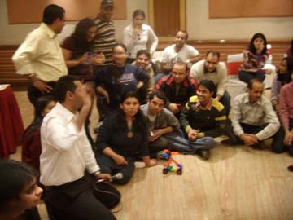
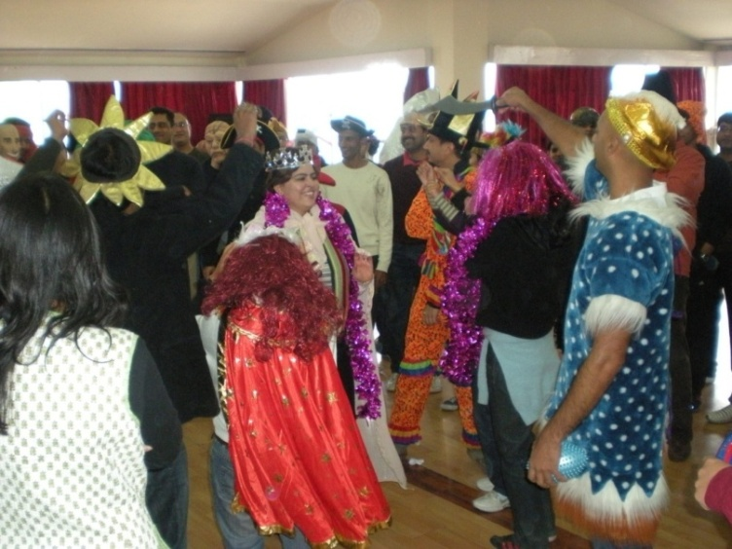
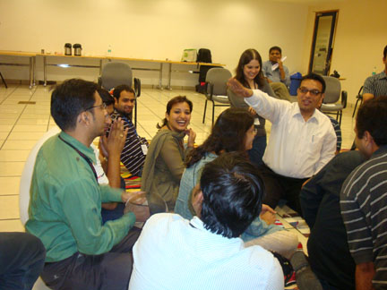
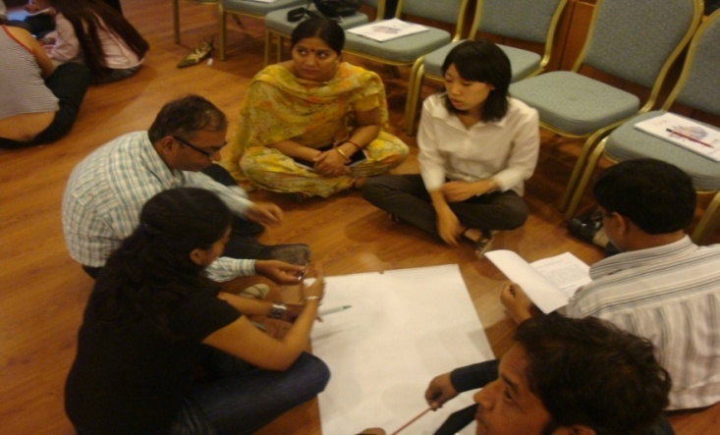
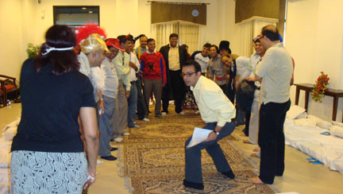
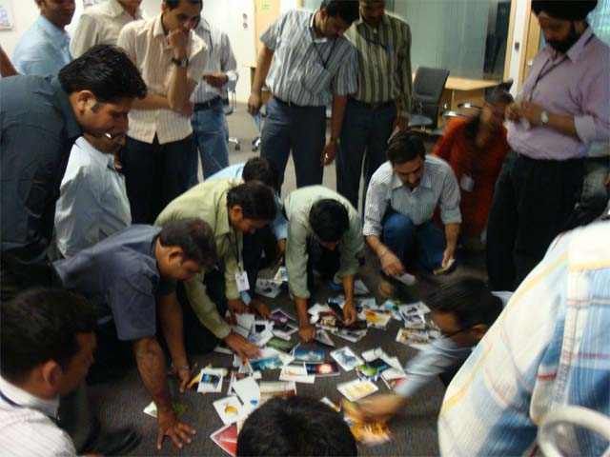
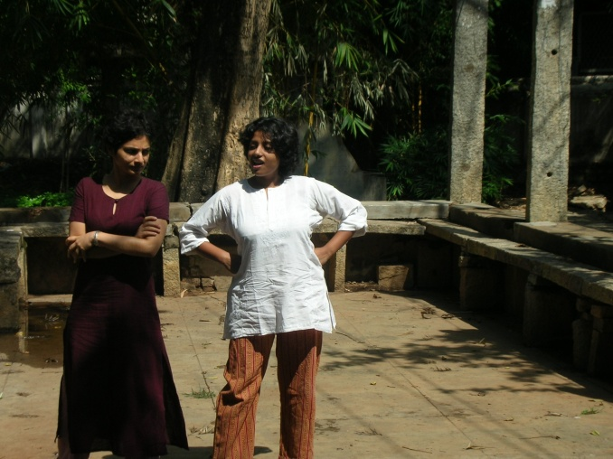
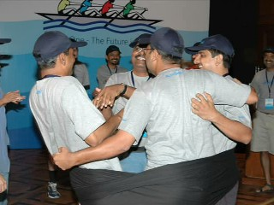
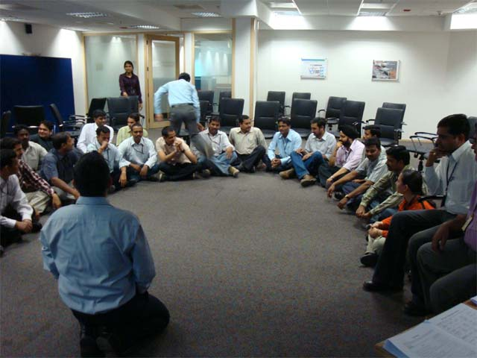
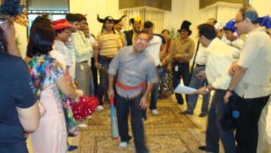

Slide 30

































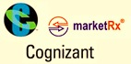





















Our Clients
Notes:
30

Slide 31
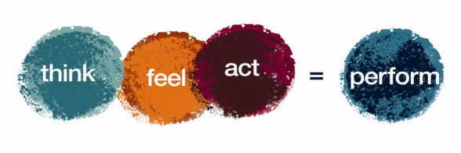

Let’s work in partnership to create impact & unlock potential
For further information please connect with:
Contact Jigyasa Sharma/ Varun Gupta
Email jigyasa@maynardleigh.in/ varun@maynardleigh.in
Telephone +91 97179 22445/ +91 9560192443

